Slide 1
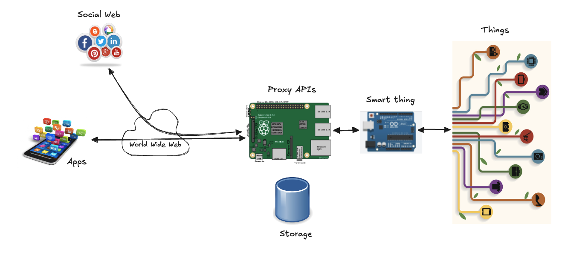
REST API

Slide 2
RPC (Remote Procedure Call)
Context: distributed applications
Communication follows the patterns of normal function calls, except that the function is running on another machine
Calling it involves:
making a request to the server that includes the function’s name and arguments
the response to that request contains the returned value
When thinking in terms of RPC, HTTP is just a vehicle for communication, and you will most likely write an abstraction layer that hides it entirely
Another approach is to build your communication around the concept of resources and HTTP methods:
instead of a remote procedure called “addUser”, you use a POST request to /users/larry
instead of encoding that user’s properties in function arguments, you define a document format, or use an existing format, that represents a user
the body of the POST request to create a new resource is such document
a resource is fetched by making a GET request to the resource’s URL, which returns the document representing the resource
It makes easier to use HTTP features
support for caching resources
coherence of the interface
simple to use by other developer

Slide 3
Representational State-Transfer (REST)
A set of architectural principles that any distributed system can adopt
formalized in Roy Fielding's PhD thesis
these properties are what made the Web so successful
if the architecture of a distributed system follows the REST constraints, that system is said to be RESTful
“REST provides a set of architectural constraints that, when applied as a whole, emphasizes scalability of component interactions, generality of interfaces, independent deployment of components to reduce interaction latency, enforce security, and encapsulate legacy systems”
Constraints:
Client-server
Uniform interfaces
Stateless
Cacheable
Layered system

Slide 4
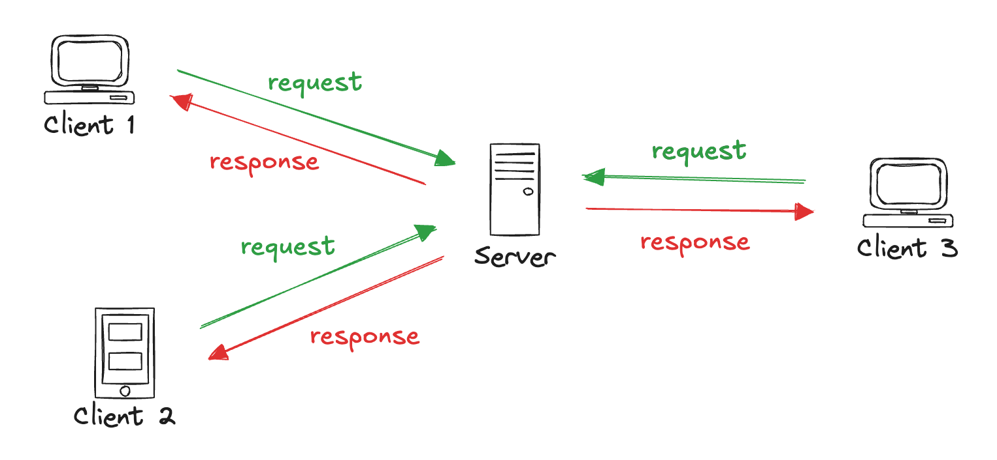
Constraint 1: client-server
Interactions are based on the request-response pattern
a client sends a request to a server and gets back a response
This maximizes decoupling between components
clients don’t need to know anything about the implementation of the server
only how to send the request to get the data they want
servers don’t need to know about the state of clients or how that data will be used
Separation of concerns between data, control logic, and presentation
scalability
portability
Loose coupling : each component can exist and evolve independently

Slide 5
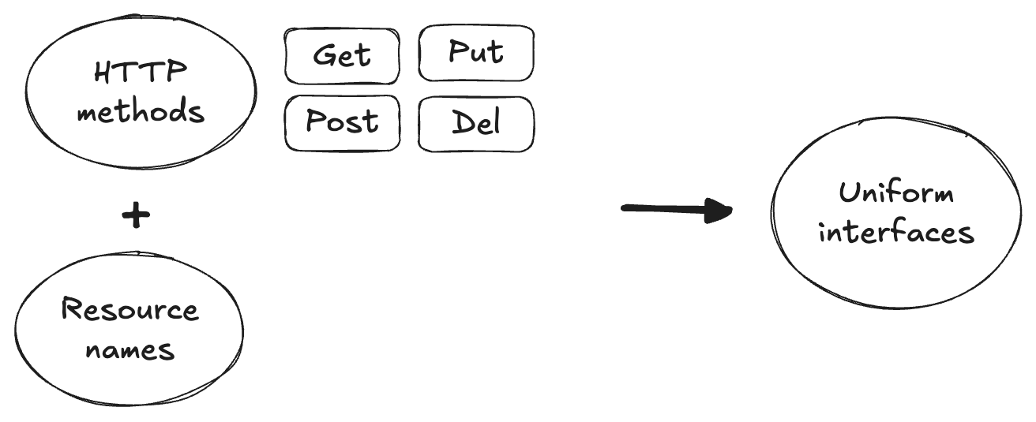
Constraint 2: Uniform interfaces
Loose coupling can only be achieved when using a uniform interface that all components in the system respect
Unambiguous, simple, and standard interfaces that can be easily extended for all sorts of content and scenarios
This have largely contributed to the success of the Web as an open and participatory system. This is also essential for the Web of Things
new, unknown devices will be added and removed to the system at any time, and interacting with them shall require minimal effort

Slide 6
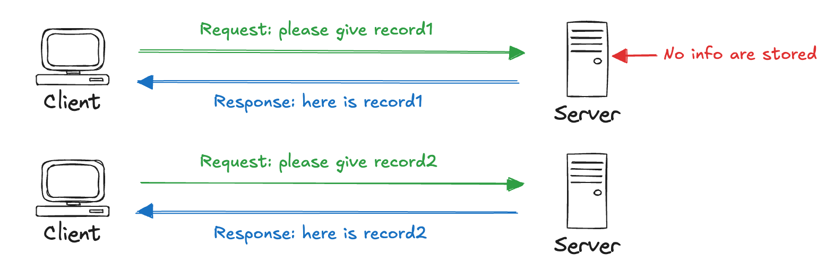
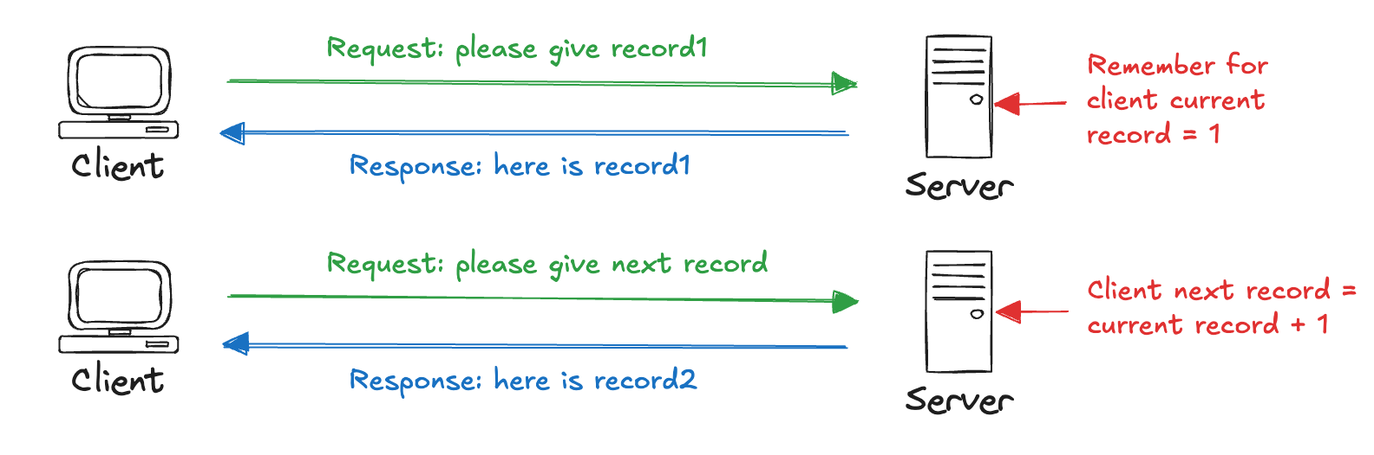
Constraint 3: Stateless
The client context and state should not be kept on the server, but only on the client: each request should contain the client state
This improve:
visibility: monitoring and debugging of server
robustness: recovering from network or application failures
scalability
Of course, servers and applications can be stateful as this constraint simply requires that interactions contain information about each other’s state
A Stateless Server
A Stateful Server

Slide 7
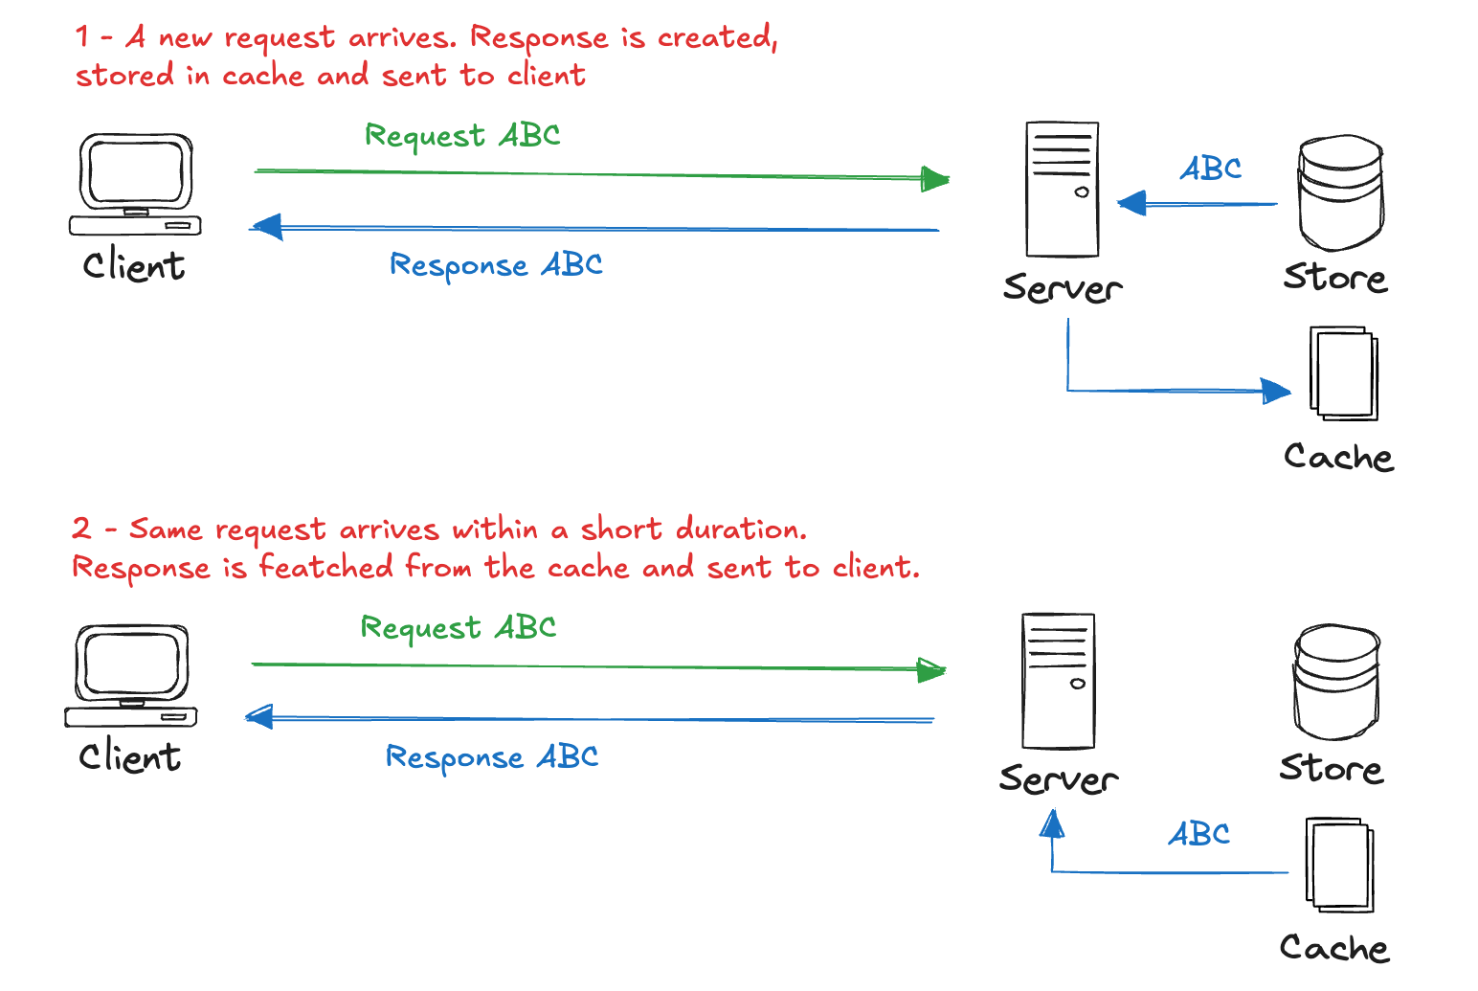
Constraint 4: Cacheable
Caching has been a key element in the performance (loading time) of the Web today
Servers, clients and intermediaries can store some data locally, which boosts their loading time, as that data doesn’t need to be fetched from the actual server for each request
Servers can define policies when data expires and when updates must be reloaded from the server
Improvements:
better performance
server scalability
reduced latency

Slide 8
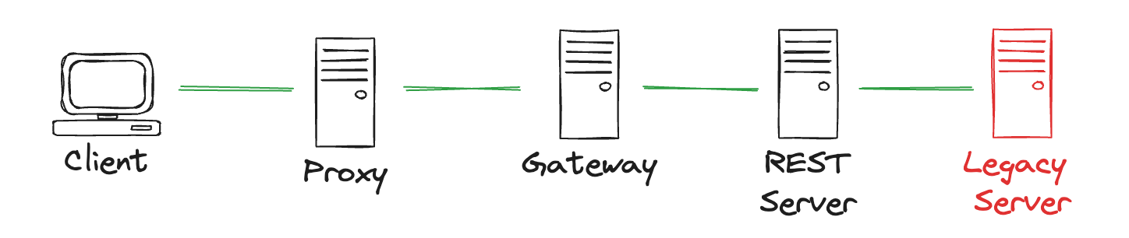
Constraint 5: Layered System
Several intermediate components to make possible to leverage intermediary servers to improve scalability and response times
For example: distributed caches can cache data in various locations throughout the globe to allow clients to retrieve some data faster
This is possible because clients don’t need to know if they interact with the target server or some other proxy along the way
Another benefit: it enables encapsulation of legacy systems (for example proprietary protocols)

Slide 9
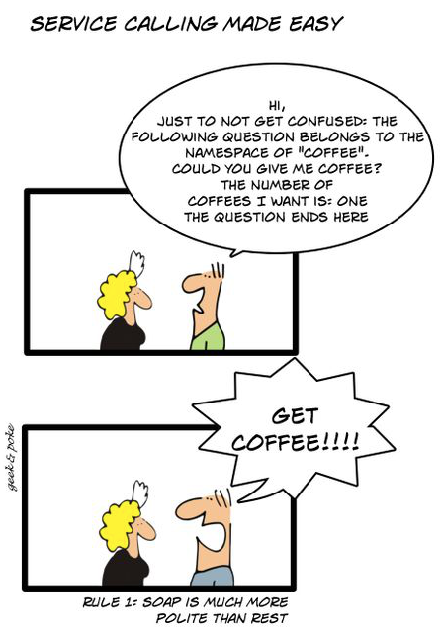
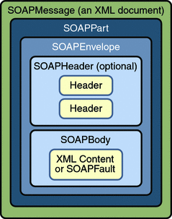
SOAP vs REST
SOAP: Simple Object Access Protocol
SOAP is dead!

Slide 10
REST Resources
The most important of these constraints is the uniform interface:
minimizes the coupling between components, which helps to design more scalable and robust applications
allows the use of a Web-like mindset to design applications (markup languages, event-based browser interactions, scripting languages, URLs, etc.)
HTTP traffic on port 80 is the only protocol that is always permitted by most firewalls
makes it easy to hide low-level protocol details behind simple, high-level abstractions, which promotes openness, programmability, and reusability of services and data regardless of how it is stored or encoded
The point is that what REST and HTTP have done for the Web, they can also do for the Web of Things
make it possible for any physical object to be accessed via the same uniform interface as the rest of the Web
The uniform interface of the Web is based on four principles:
Addressable Resources
Manipulation of resource through representations
Self-descriptive messages
Hypermedia as the engine of the application state (HATEOAS)

Slide 11
Principle 1: Addressable Resources
A resource is any concept or piece of data in an application
Every resource must have a unique identifier and should be addressable using a unique referencing mechanism
on the Web, this is done by assigning every resource a unique URI
Using the same standard naming scheme as all other Web resources allows to seamlessly integrate Things and their properties into the Web
functions, data, or sensors can be linked to, shared, bookmarked, or used just like anything else on the Web
URI sintax:
<scheme> ":" <authority><path> [ "?" query ] [ "#" fragment ]
Every device on the WoT must have a root URL that corresponds to its network address:
http://gateway.api.com/devices/TV/
http://kitchen-raspberry.device-lab.co.uk/
https://192.168.10.10:9002/
https://kitchen:3000/fridge/
In WoT we can have several types of resources: some of them represent Things and their actual properties, others can be entirely virtual
a mashup, a data processing service, etc.

Slide 12
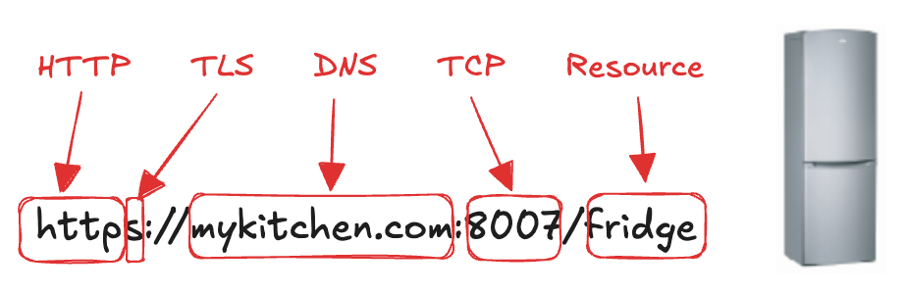
Principle 1: Addressable Resources
Resources are often organized in a hierarchy defined by a path
In WoT it can be used to identify the relationship between Things and their physical location
# a list of sensors on a device (all the sensors on device ID 24)
http://devices.webofthings.io/24/sensors
# a list of devices in an area (building 4)
http://192.168.44.12/building4/devices/
# a list of sensor readings
https://webofthings.org/devices/4554/samples

Slide 13
Principle 1: Addressable Resources
No official rules about the semantics of resources' identifiers
Guidelines
Use descriptive names
as the resource names appear in the URLs, using names with some semantic value can be of great help to developers and users
Don’t use verbs in the URLs
specify names only
/garagedoor/openDoor is bad, /garagedoor/status is good
verbs are for HTTP methods, not for URLs
Use the plural form for aggregate resources
if a Thing has several sensors, they should be accessible via a parent resource called /sensors

Slide 14
Principle 2: Representations
A resource is only a concept (abstract idea of a thing), NOT the thing itself
The tangible instance of a resource is called a representation, which is a standard encoding of a resource using a type
Standards:
Multipurpose Internet Mail Extensions (MIME) describes data formats for Internet
the type for an image encoded as PNG is expressed with image/png
the type for an MP3 audio file with audio/mp3
Internet Assigned Numbers Authority (IANA) maintains the list of the all official MIME types
HTTP Content Negotiation mechanism!
Formats for WoT
today, the best format is JSON
lightweight, portable, self-contained, and can be easily parsed
however, it isn’t a binary format as it is still text
Alternative representations formats make sense when a more efficient format is needed
memory limitations of a device or the fact that it runs on batteries
formats to translate JSON into a binary format
e.g. MessagePack (https://msgpack.org/)
Guidelines:
Things MUST support JSON as their default representation
Things MAY offer an HTML interface/representation (UI)

Slide 15
Principle 3: Self-descriptive messages
REST emphasizes that every resource must support a standard, common set of operations with clearly defined semantics and behaviour
HTTP verbs: GET, POST, PUT, DELETE.
Enable loose coupling:
clients only need to support mechanisms to handle these methods
In WoT, these operations map naturally:
things usually offer simple and atomic services
usually reduced to the four basic CRUD operation types (Create, Read, Update, Delete)
HTTP errors: a lightweight, powerful and standard way of notifying abnormal and successful request execution
Guidelines:
Web Things MUST support the GET to retrieve a sensor resource (e.g., a temperature reading), POST to create a new resource (e.g., to create a rule) that will get a new URL, PUT to update an actuator resource given its URL (e.g., updating an LED) and DELETE is used to remove a resource from a collection of resources (e.g., removing a rule).
Web Things MUST implement HTTP status codes 20x, 40x, 50x
Web Things MUST support a GET on their root URL, so that a client is always able to access information about the device

Slide 16
Principle 4: HATEOAS
HATEOAS: Hypermedia as the Engine of Application State
Two sub-concepts
Hypermedia
the idea of using links as connection between related resources
Application State
a step in a process or workflow
Each possible state needs to be a RESTful resource with its own unique URL, where any client can retrieve a representation of the current state and the possible transitions to other states
the status of a LED is kept on the server
each request is answered with a representation of the current state and with the necessary information on how to change the LED state
Links are very important in WoT since they enable clients to discover related resources
by browsing (in the case of a human user following links on pages)
by crawling (in the case of a machine)
In short, linking resources allows them to be dynamically discovered and re-arranged without having to keep a “sitemap” somewhere

Slide 17

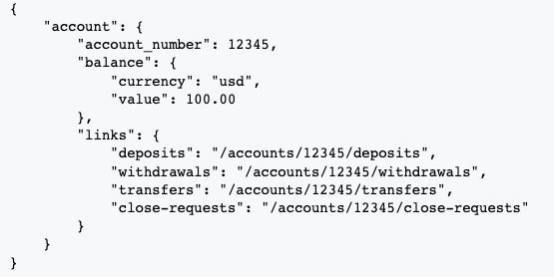
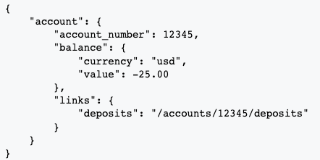
Principle 4: HATEOAS
For example, this GET request fetches an account, requesting details in a JSON representation
The response contains possible follow-up links: POST a deposit, withdrawal, transfer, or close request (to close the account).
As an example, later, after the account has been overdrawn, there is a different set of available links, because the account is overdrawn.

Slide 18
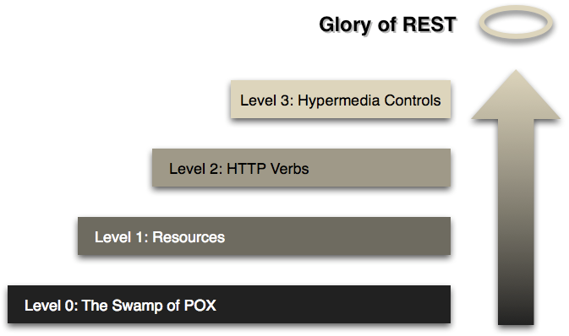
Richardson Maturity Model

Slide 19
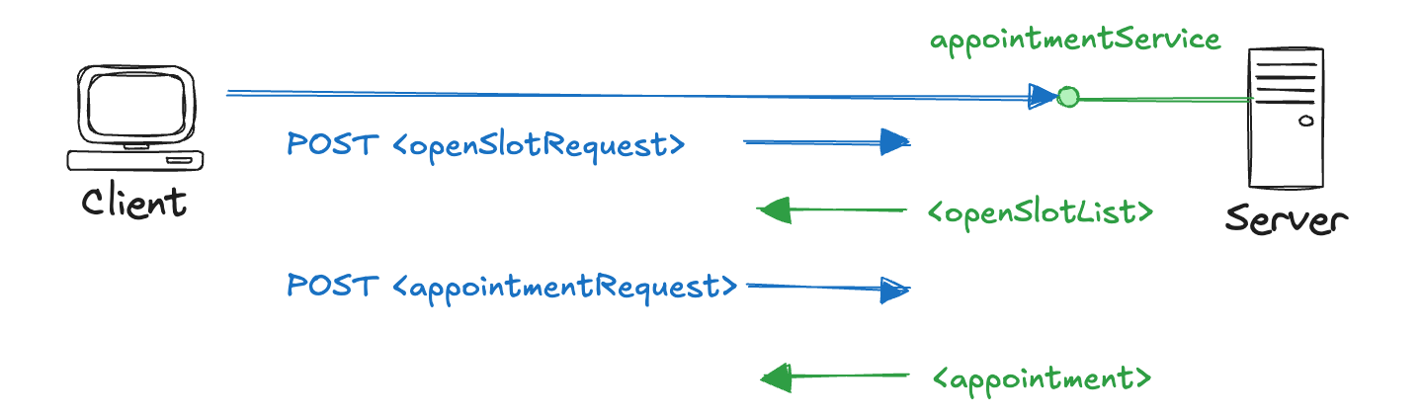
Level 0 - RPC (no REST)
“The Swamp of POX” : palude del vaiolo, POX “Plain Old XML”

Slide 20
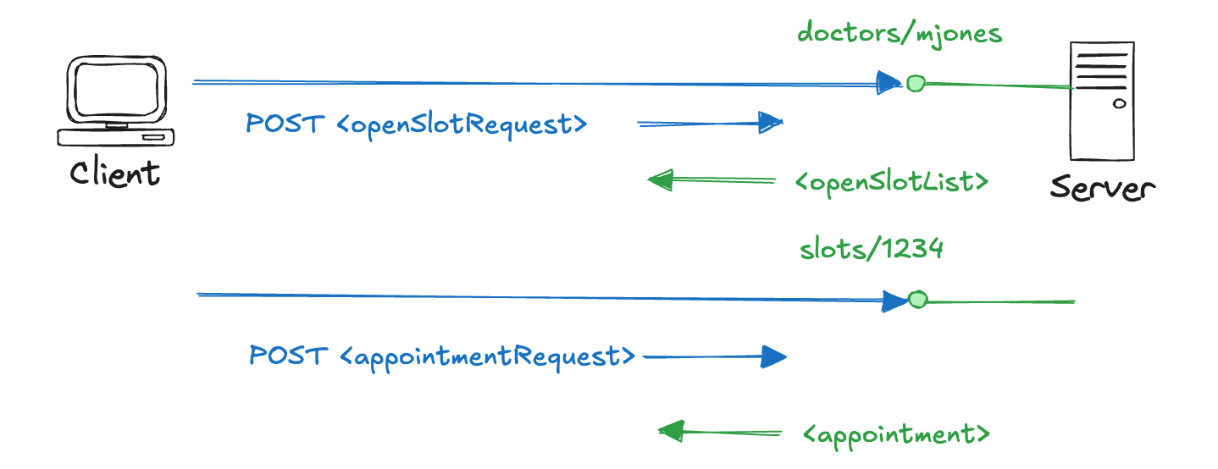
Level 1 - Resources

Slide 21
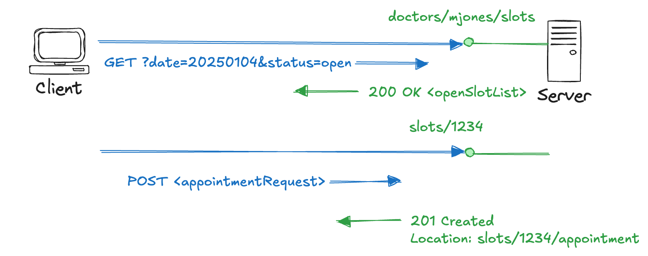
Level 2 - HTTP Verbs

Slide 22
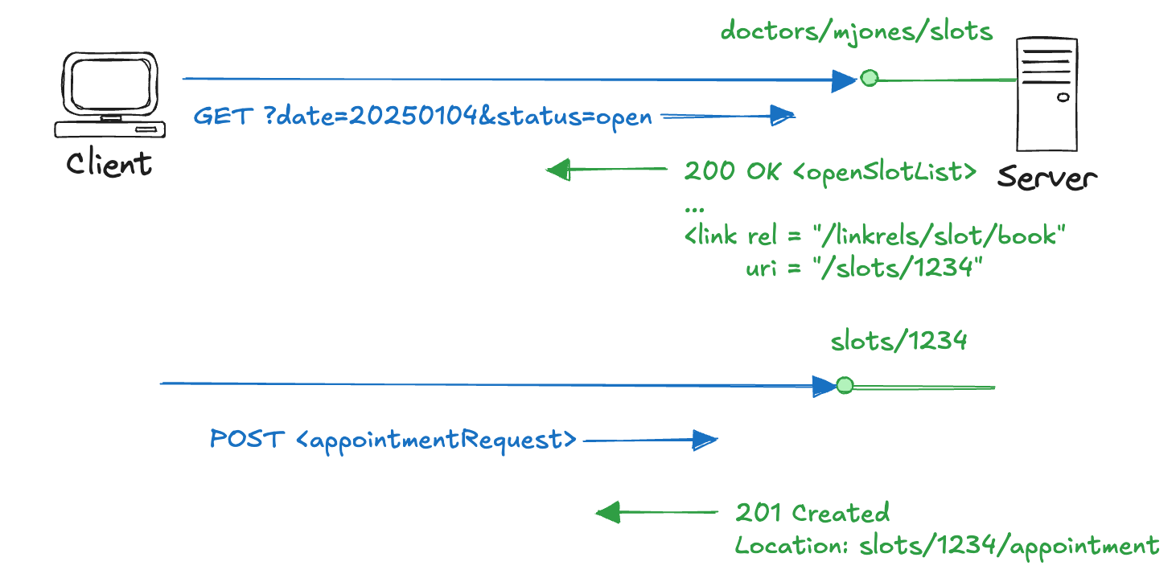
Level 3 - Hypermedia Controls

Slide 23
The Glory of REST
Level 1 tackles the question of handling complexity by using divide and conquer, breaking a large service endpoint down into multiple resources
Level 2 introduces a standard set of verbs so that we handle similar situations in the same way, removing unnecessary variation
Level 3 introduces discoverability, providing a way of making a protocol more self-documenting
APIs for Things can be built by reusing patterns from the architecture of the Web. Instead of using the Web solely as a transport protocol, we make Things an integral part of the Web and its infrastructure by using HTTP for what it was intended: as an application layer protocol

Slide 24
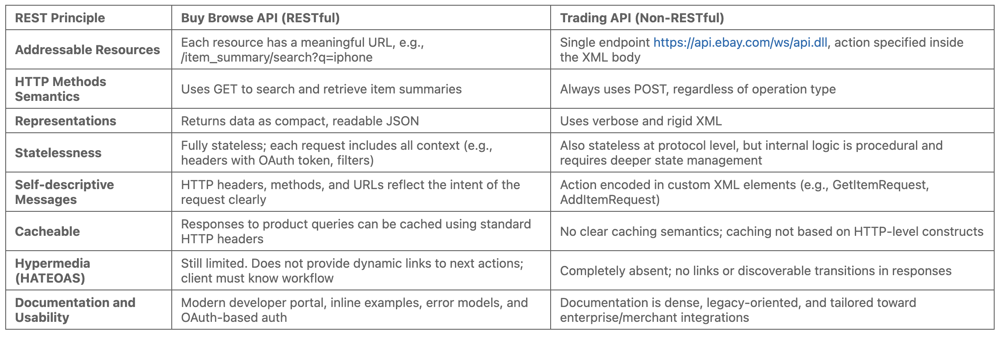
Real-World Examples
Twitter
https://dev.twitter.com/overview/documentation
Ebay
http://developer.ebay.com/Devzone/XML/docs/Reference/eBay/index.html
https://developer.ebay.com/api-docs/buy/browse/resources/item_summary/methods/search#_samples
PayPal
https://developer.paypal.com/docs/api/

Slide 25
Beyond REST: the Real-Time
Until now, our API only offers access through the HTTP protocol: clients always initiate the communication with the server by sending requests and expecting a response (request-response communication)
In WoT this works well only when clients need send requests to Things
e.g. a mobile application that retrieves a value of a sensor reading
Unfortunately, request-response model is insufficient, it does not match event-driven use cases where events must be communicated (“pushed”) to the clients as they happen
Client-initiated model is not practical for applications where notifications need to be sent asynchronously by a device
e.g. a security camera or smoke alarm must be able to send an alert immediately when any anomaly has been detected
The WoT needs Events!

Slide 26
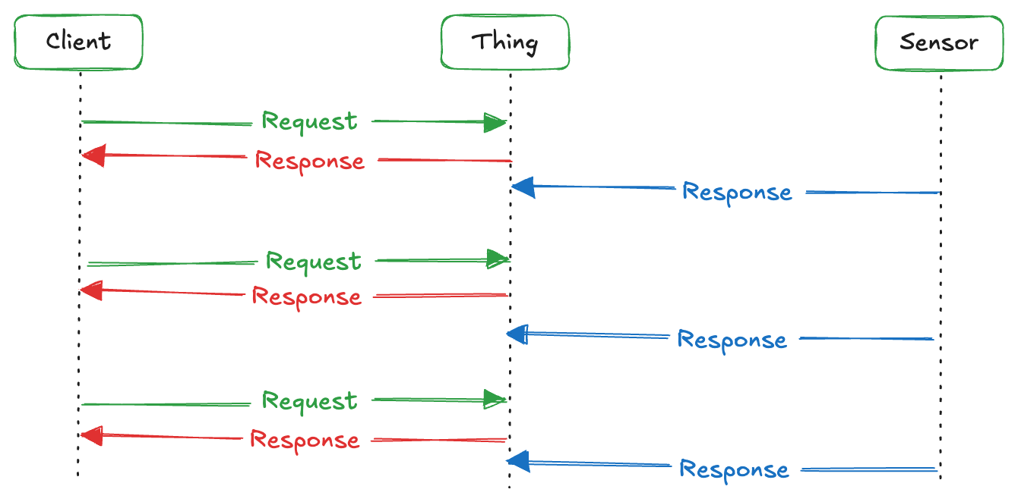
Basic Polling
Clients can request updates periodically from a Thing by sending a GET request on a regular basis
near real-time behaviour can be simulated sending the same request continuously
Really inefficient for two reasons:
it generates a great number of HTTP calls, and a great part of these calls are void, it doesn’t scale well when the number of clients increase
a large amount of HTTP calls is a problem for battery-powered devices, where only the strict necessary data should be sent

Slide 27
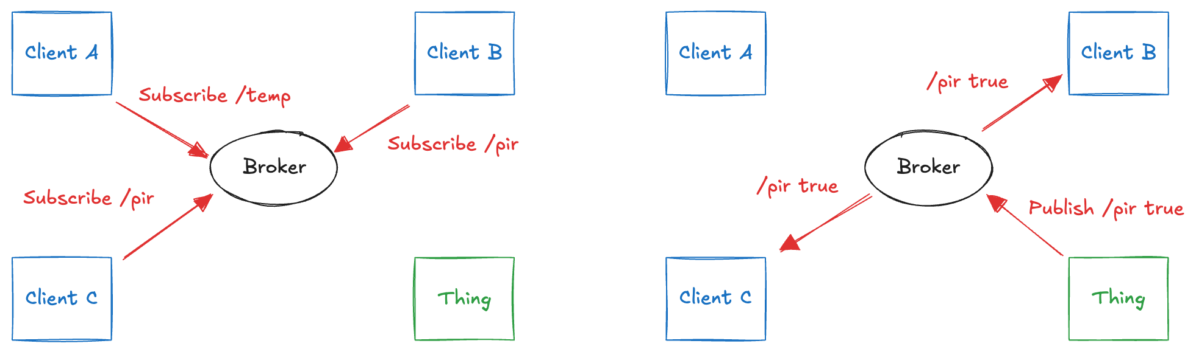
Publish/Subscribe
On top of the request-response pattern we need a publish/subscribe model (Pub/Sub)
decoupling between data consumers (subscribers) and producers (publishers)
Publishers send messages to a central server (broker) that handles the routing and distribution of the messages to the various subscribers, depending on the type or content of messages
simple analogy: a chat room, some are public, some are private; sometimes, you chat to only one person, sometimes thousands.
How to implement it with technologies supported on the Web?
candidates: Web Hooks, Long Polling and WebSockets

Slide 28
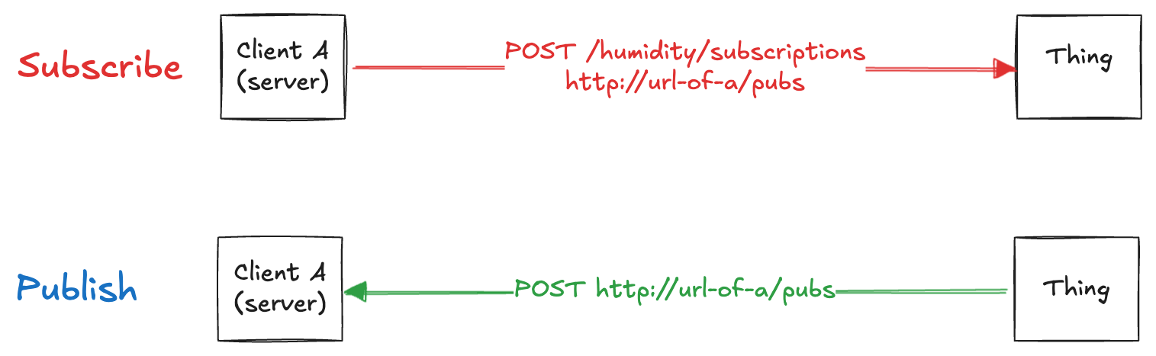
WebHooks – HTTP Callbacks
Treat every entity both as a client and a server
very popular on the Web to enable different servers to talk to each other
used by PayPal to confirm to eBay (or any other site) that your payment has been accepted
Implementation: a REST API both on the Thing and the client side (which also becomes a server)
when the client wants to get an update, the Thing POSTs it via HTTP on the client
One big drawback
only works when the subscriber has a publicly accessible URL or IP address
in the real world this is very limiting, as it will rarely be the case beyond server-to-server communication

Slide 29
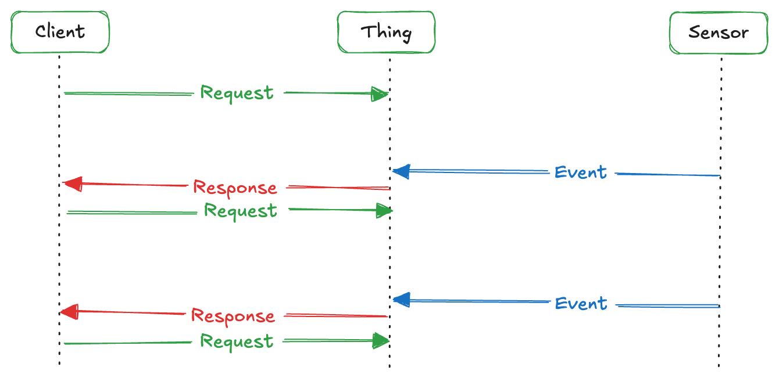
Long polling
The client sends a request to the server, that holds the request until an event is received, which is injected into the response returned. The client immediately send a new request and so on
the latency for events to reach the client is thus minimized
The client must be put on hold with an open HTTP request that is waiting for an answer and must send a request after each response
Long polling is a workaround (useful), but not a solutions

Slide 30
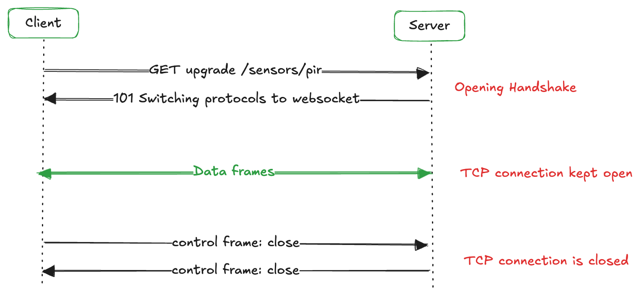
WebSockets
A Web protocol for push communications
it creates a “permanent” link between client and server that both can use
A WebSocket has three steps:
send an HTTP call with a special header asking for protocol upgrading
if the server supports WebSockets it will reply with a 101 Switching Protocols status code
client and server can send messages back and forth over the open TCP connection
not HTTP messages but WebSocket data frames
overhead: 2 bytes, very small compared to the 871 bytes of an HTTP message

Slide 31
Hands-on Activity
Design and implement (using NodeJS and Express) a RESTful API to manage a university course. You have to design resources (like students, exams, grades, etc.), routes (taking into account hierarchy, like /students/id/exams), representations (the JSON body of each resource).
We don’t have any database technology until now, so, please keeps data in memory using arrays.

